Slide 1
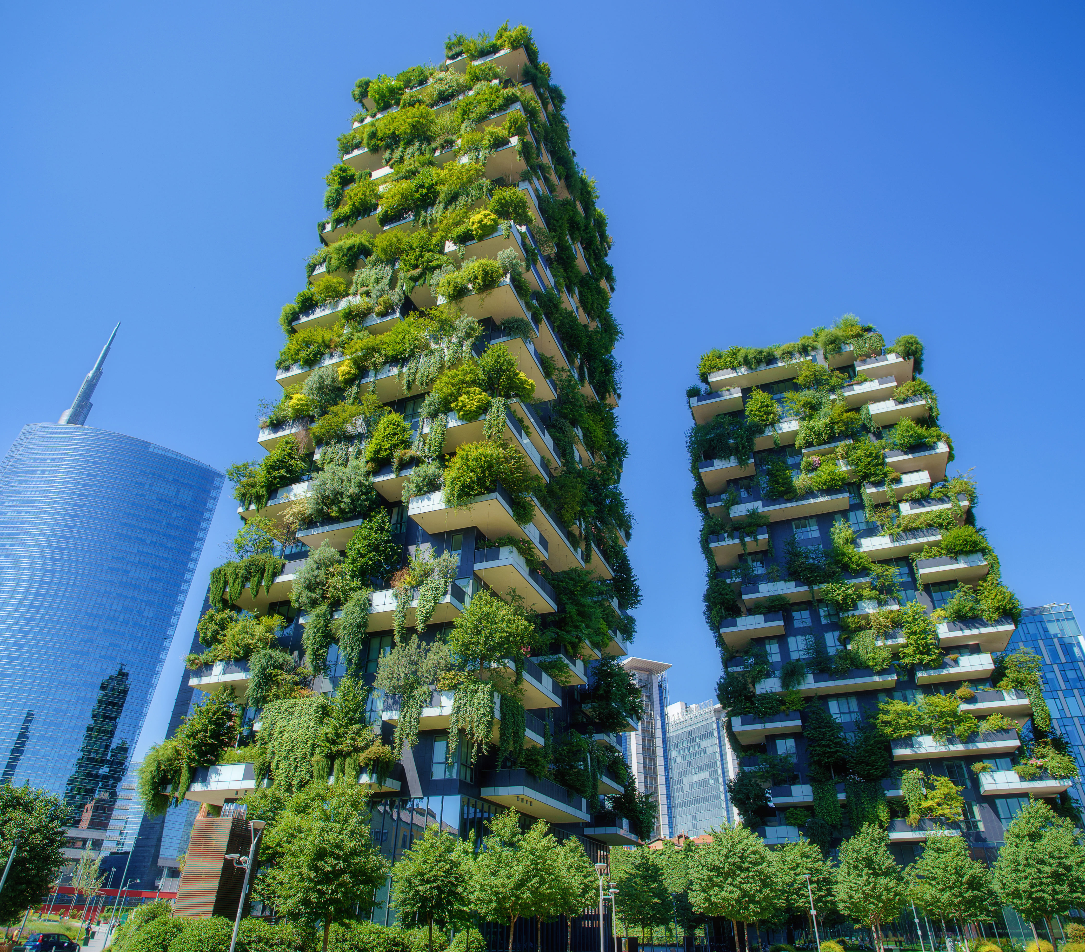
Sustainable Urban Planning and Development
Strategies for Creating Sustainable Cities
Tejus

Slide 2
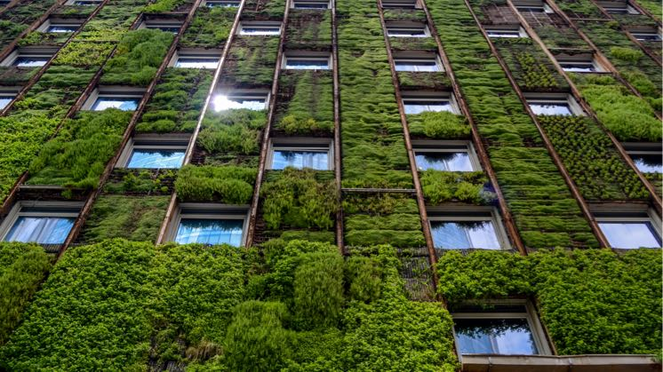
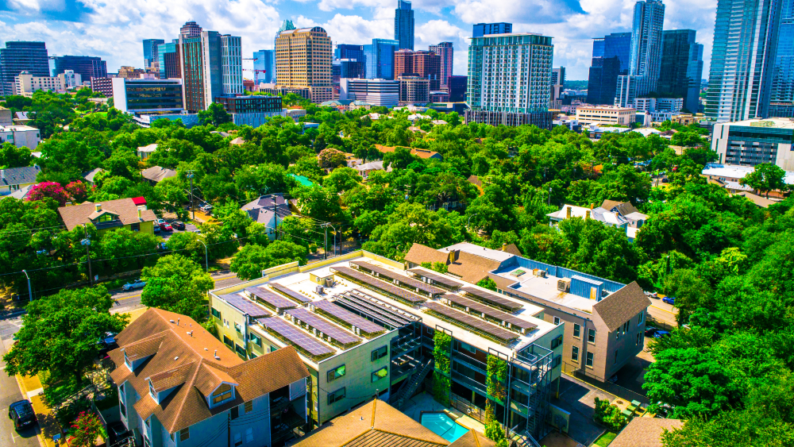
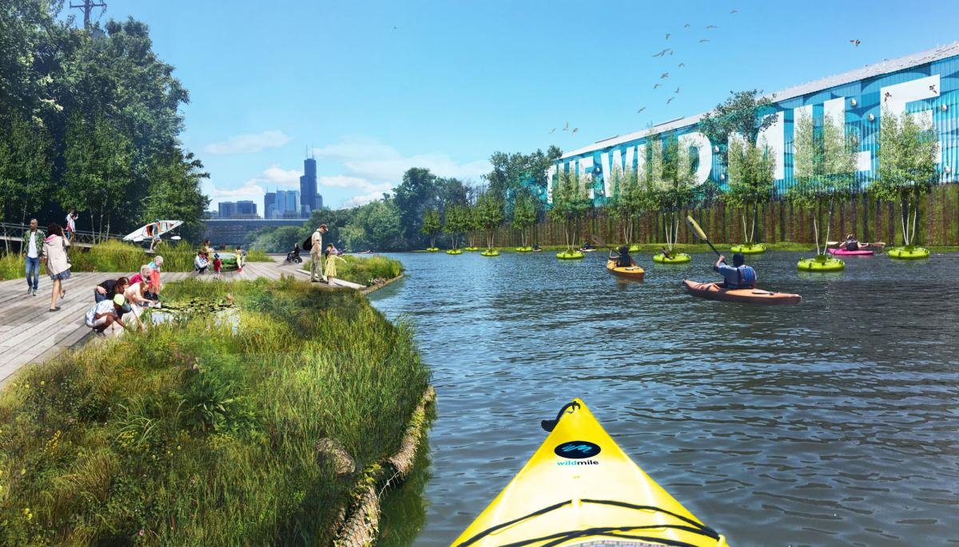
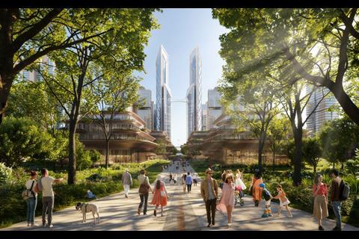
Agenda
Importance to Sustainable Urban Planning
Core Principles of Sustainable Urban Planning
Strategies for Implementing Sustainable Urban Development
Case Studies of Successful Sustainable Cities
Role of Civil Engineers and Challenges in Sustainable Development

Slide 3
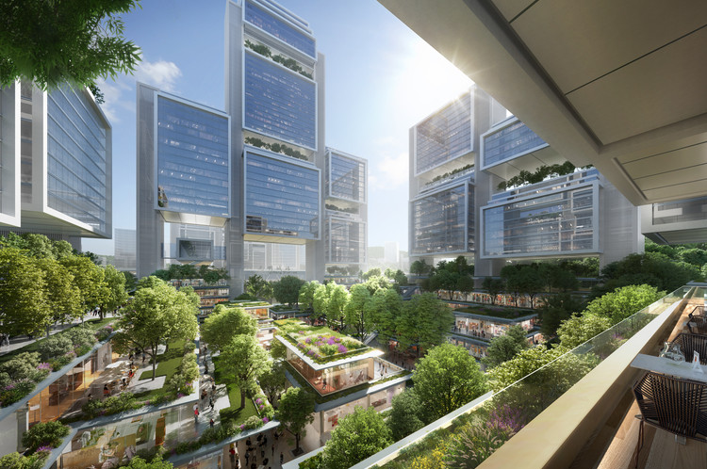
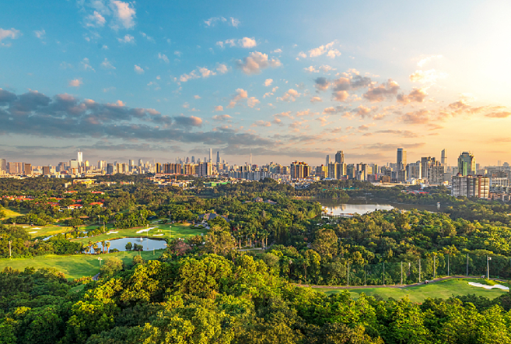
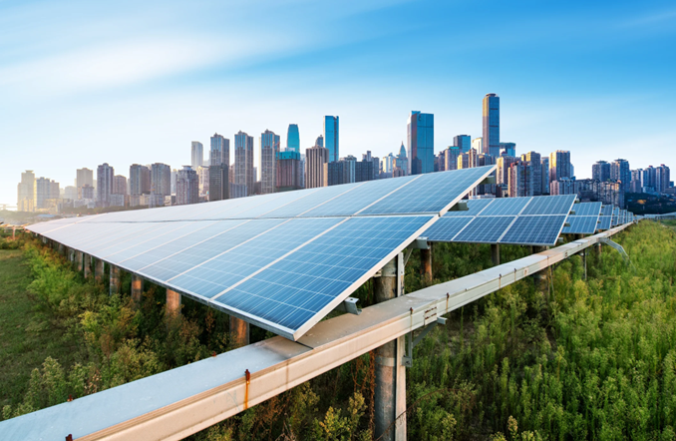
Introduction
Sustainable Urban Planning involves designing urban areas that balance economic, social, and environmental needs for long-term viability. This presentation will cover core principles, effective strategies, successful case studies, the role of civil engineers, challenges faced, innovative solutions, and policy frameworks to promote sustainable development in urban settings.

Slide 4

Importance of Sustainability in Urban Development
Triple Bottom Line Benefits

Slide 5
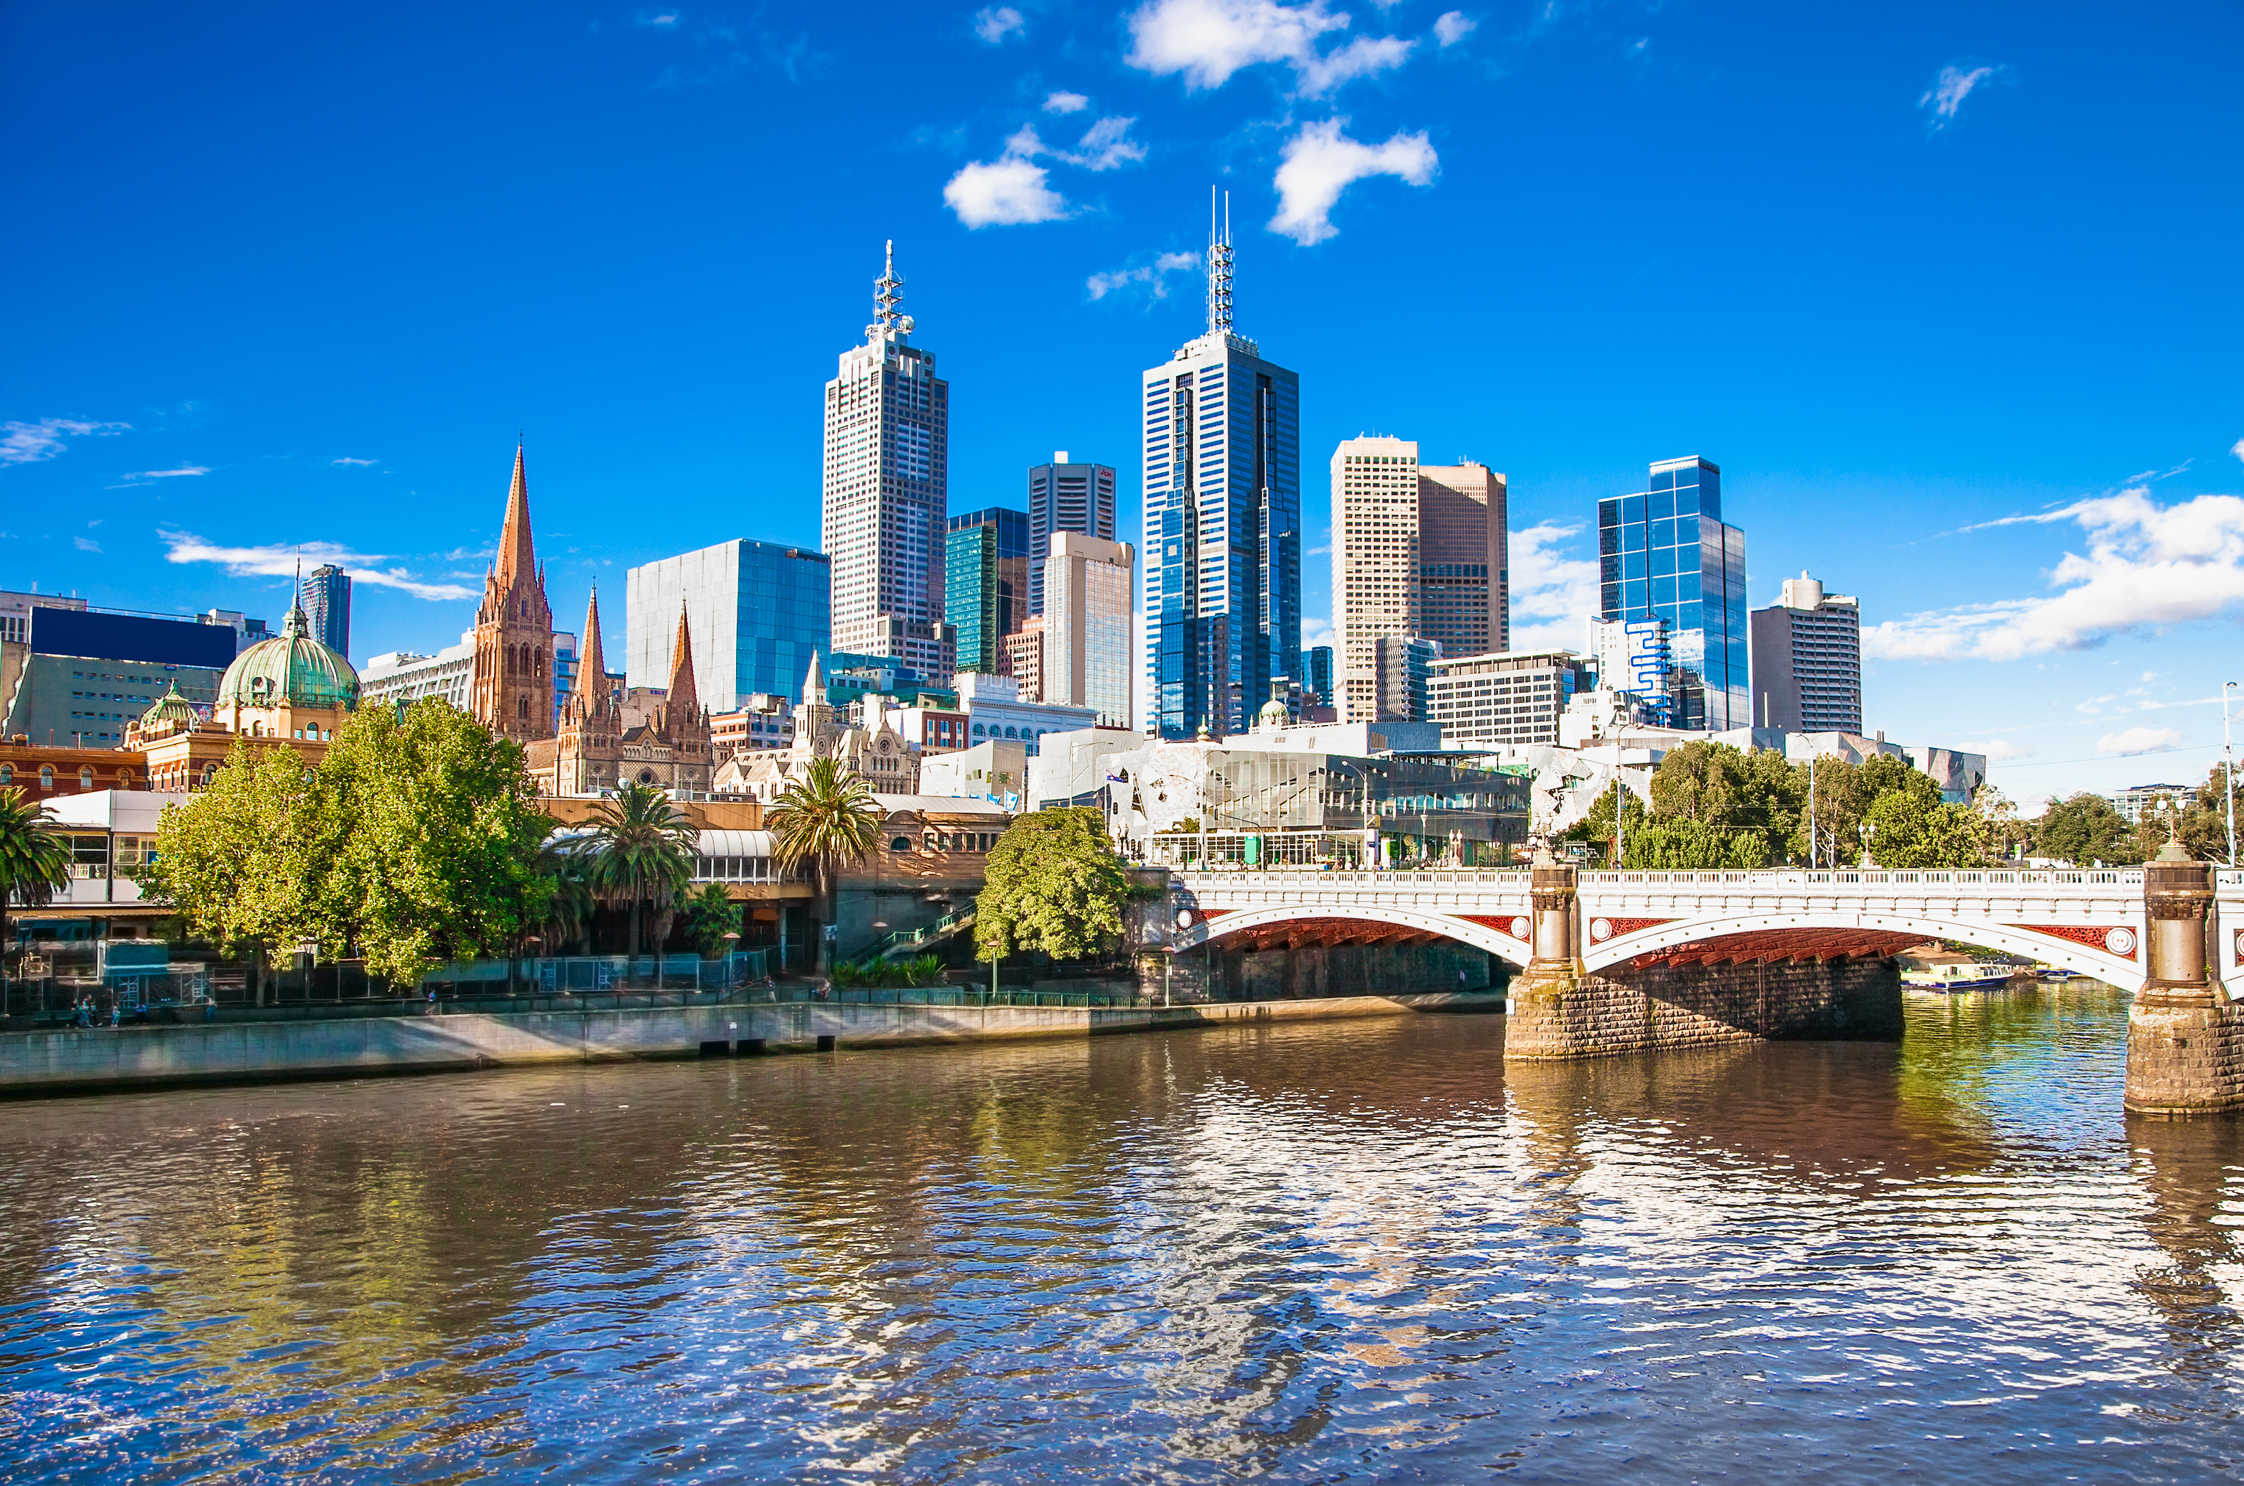
Importance of Sustainability in Urban Development
Environmental Protection: Minimizes ecological impact, preserves natural resources, and promotes biodiversity.
Social Equity: Ensures equitable access to resources, opportunities, and services for all community members.
Economic Growth: Supports long-term economic stability, resilience, and growth through sustainable practices and investments.

Slide 6
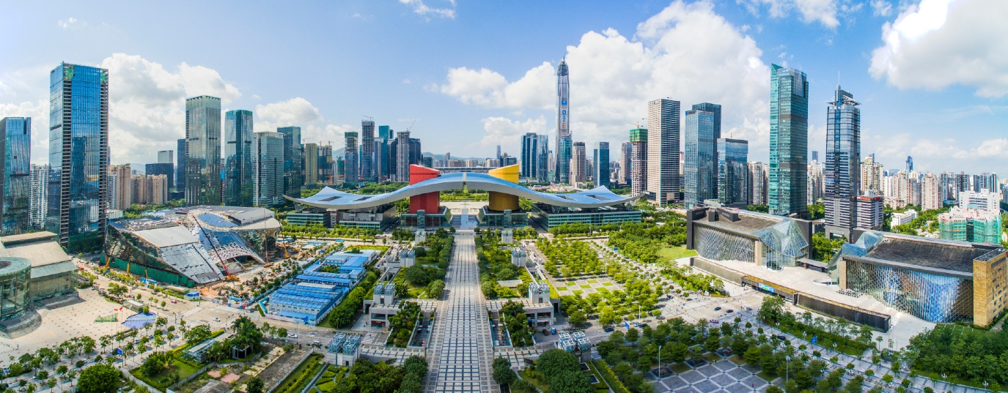
Core Principles of Sustainable Urban Planning
Foundations for Sustainable Cities

Slide 7
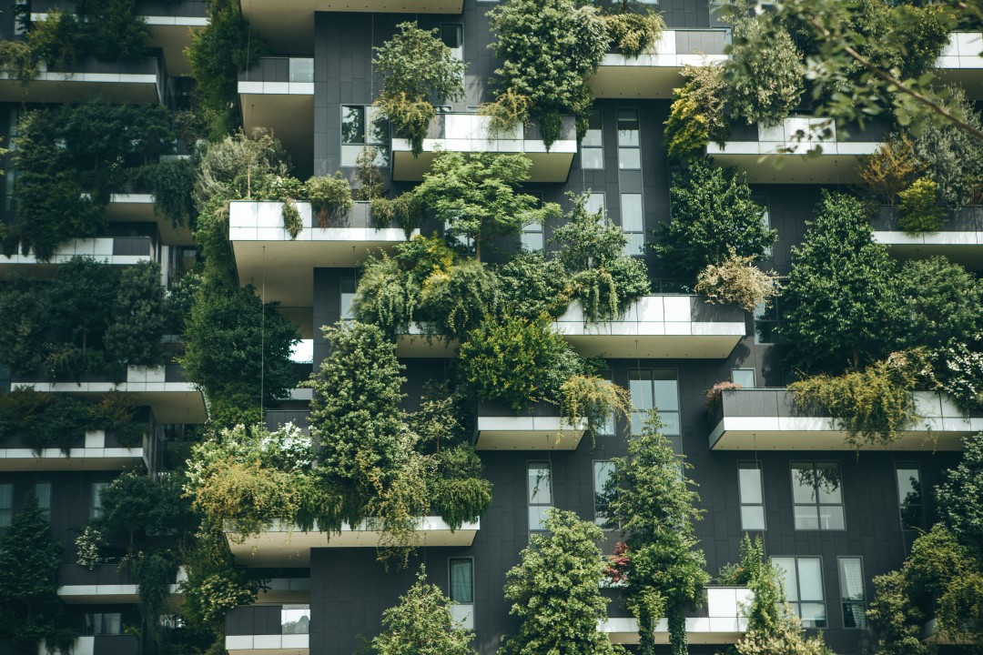
Promote inclusivity, social cohesion, and community well-being.
Balance economic growth with sustainable practices for long-term prosperity and resilience.
Core Principles of Sustainable Urban Planning
Ensure equitable access to resources, services, and opportunities for all residents.
Minimize environmental impact and preserve natural resources

Slide 8
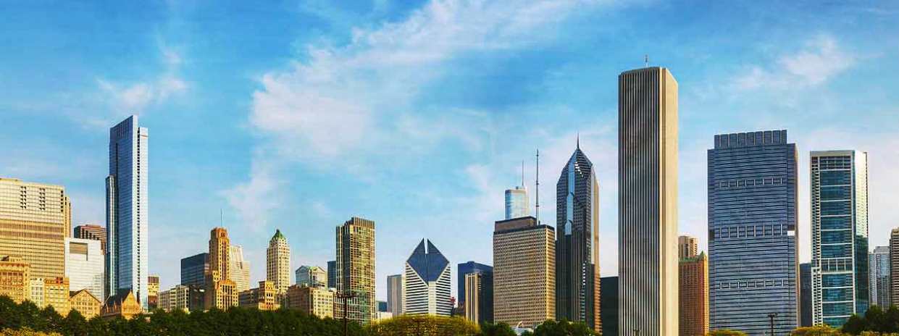
Strategies for Implementing Sustainable Urban Development
Building Sustainable Cities

Slide 9
Strategies for Implementing Sustainable Urban Development
Smart Growth Planning
Green Building Practices
Public Transportation Enhancement
Expansion of public transit networks and promotion of active transportation.
Compact and efficient land use to reduce sprawl and preserve natural areas.
Use of sustainable materials, energy-efficient design, and green infrastructure.
Mixed-Use Development
Integration of residential, commercial, and recreational spaces to reduce travel distances.
Waste Management and Recycling
Implementation of waste reduction strategies and recycling programs.
Renewable Energy Integration
Adoption of renewable energy sources like solar and wind power in urban infrastructure.
Water Conservation Measures
Efficient water use, rainwater harvesting, and green stormwater management.
Community Engagement and Education
Involve residents in sustainability initiatives and promote awareness through education.

Slide 10
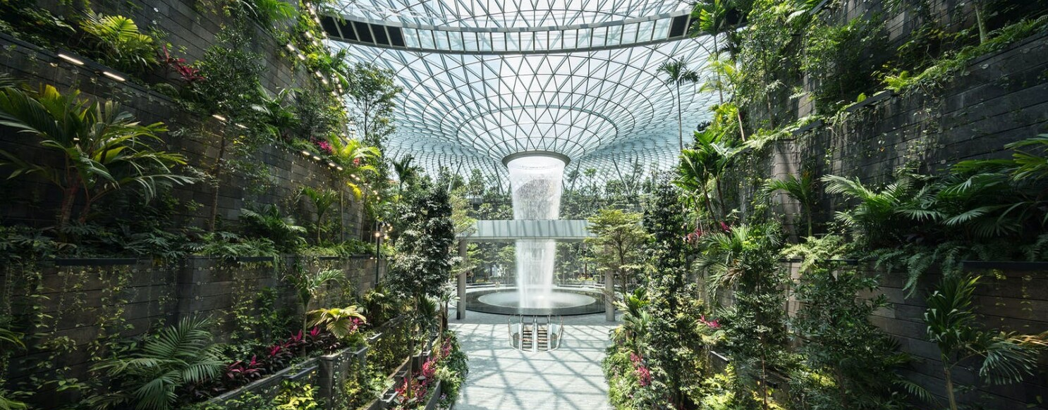
Case Studies of Successful Sustainable Cities
Realizing Sustainable Urban Vision

Slide 11
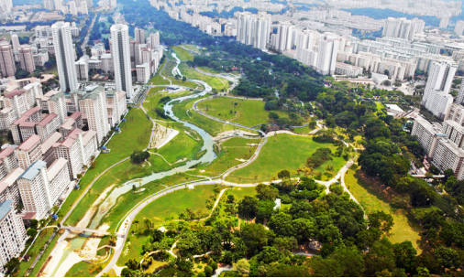
Curitiba, Brazil: A Model of Sustainable Urban Planning
Integrated Public Transport
Bus Rapid Transit (BRT) System: Curitiba’s BRT system, implemented in the 1970s, features dedicated lanes for buses, ensuring efficient and rapid transit across the city. This system has significantly reduced traffic congestion and lowered carbon emissions.
High Capacity and Frequency: The BRT system serves over 2 million passengers daily, with buses arriving every 90 seconds during peak hours.
Affordable and Accessible: The fare is affordable for residents, and the system is designed to be accessible to people of all ages and abilities, promoting social inclusion.
Green Spaces
Extensive Parks: Curitiba boasts numerous parks and green spaces, such as Barigui Park and Tanguá Park, which provide recreational areas for residents and enhance the city's biodiversity.
Tree-Lined Streets: The city has implemented extensive tree-planting programs along its streets, contributing to improved air quality and providing shade to reduce urban heat island effects.
Urban Forests: Curitiba’s urban planning includes the preservation and creation of urban forests, which act as carbon sinks and support local wildlife.
Waste Management
Innovative Recycling Programs: Curitiba’s waste management system includes an efficient recycling program where residents separate recyclables at home. The city's "Green Exchange" program allows low-income residents to exchange recyclable materials for fresh produce.
Waste-to-Energy Initiatives: The city has implemented waste-to-energy plants that convert non-recyclable waste into energy, reducing landfill use and generating renewable energy.
Public Awareness and Participation: Curitiba has a strong focus on educating residents about the importance of recycling and waste reduction through community programs and school initiatives.

Slide 12
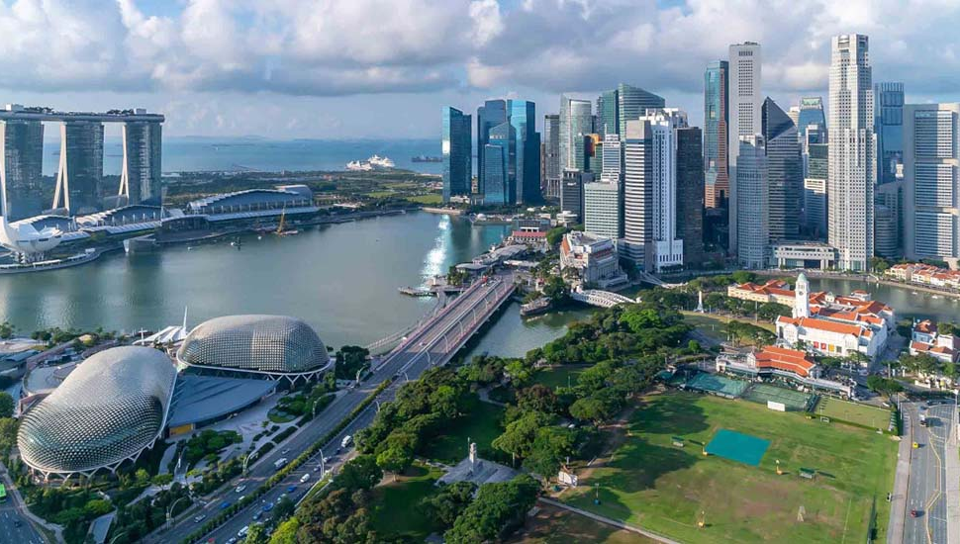
Singapore: Pioneering Sustainable Urban Development
Sustainable Urban Planning
Compact City Design: Singapore’s urban planning emphasizes a compact city design to maximize land use efficiency. This approach minimizes sprawl, reduces commuting distances, and preserves natural spaces.
Mixed-Use Developments: The city integrates residential, commercial, and recreational spaces within the same areas. Developments like Marina Bay Sands and One-North provide diverse facilities and amenities, encouraging a live-work-play environment.
Green Building Standards: Singapore promotes green building through initiatives like the Green Mark Certification, which assesses buildings on their environmental impact and sustainability. Buildings are designed to be energy-efficient, use sustainable materials, and integrate green spaces.
Green and Blue Spaces
Urban Parks and Gardens: Singapore is renowned for its extensive green spaces, such as Gardens by the Bay and the Singapore Botanic Gardens. These spaces provide recreational areas, enhance biodiversity, and improve air quality.
Vertical Greenery: High-rise buildings often feature vertical gardens and green rooftops, which help reduce heat island effects, provide insulation, and enhance the urban aesthetic.
Economic and Social Policies
Economic Resilience: Singapore’s economic policies focus on innovation, technology, and sustainability. Initiatives like the Smart Nation program drive digital transformation and sustainable growth.
Social Equity: The government ensures access to affordable housing, quality healthcare, and education for all residents. Programs like the Housing Development Board (HDB) provide subsidized housing, fostering social cohesion.
Waste Management
Zero Waste Masterplan: Singapore aims to reduce waste sent to landfills through comprehensive recycling and waste-to-energy programs. The Tuas Nexus Integrated Waste Management Facility will further enhance waste processing capabilities.
Community Engagement: Public campaigns and education programs promote recycling and waste reduction among residents, encouraging a culture of sustainability.

Slide 13
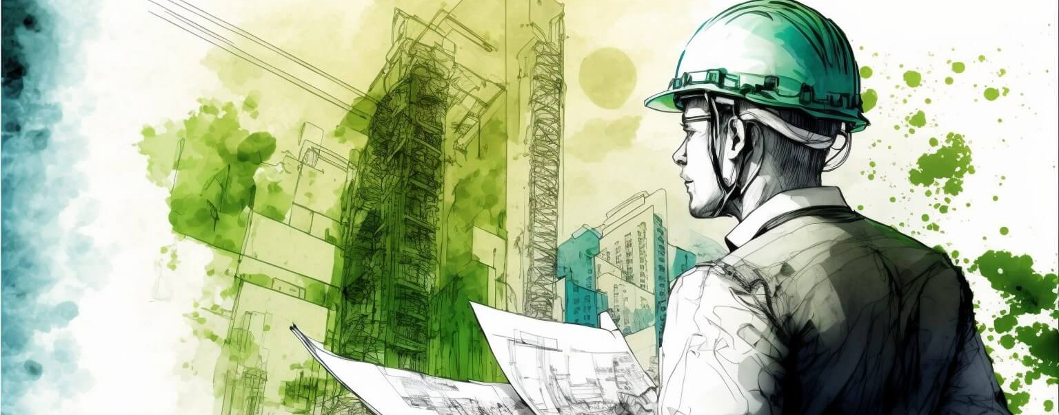
Role of Civil Engineers and Challenges in Sustainable Development
Key Players and Hurdles in Building Sustainable Cities

Slide 14
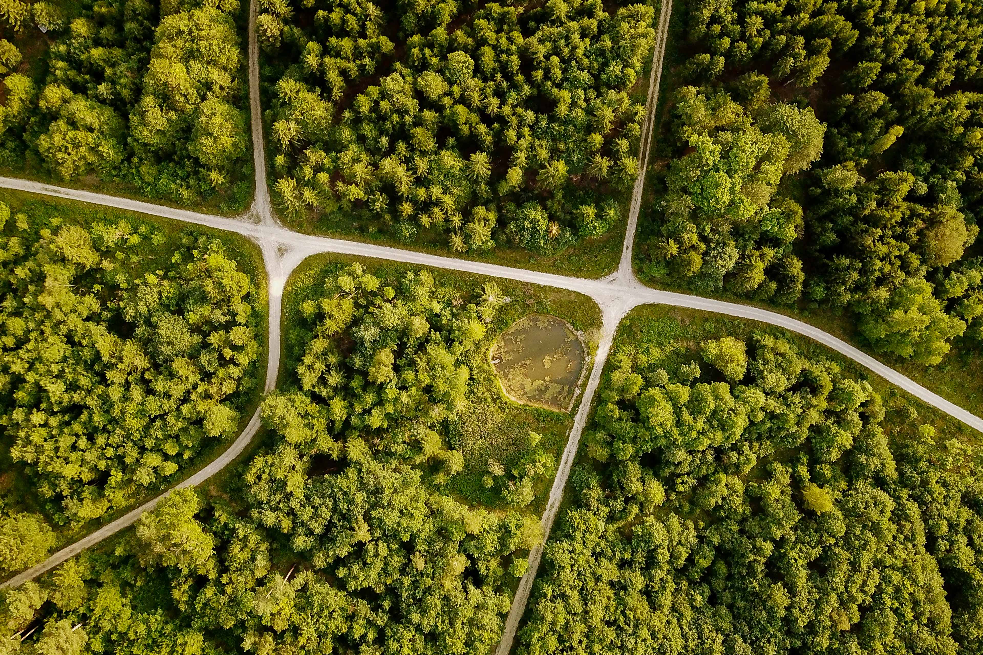
Role of Civil Engineers in Sustainable Development
Challenges in Sustainable Development
Strategies to Overcome Challenges
Design and Planning: Create sustainable, efficient, and resilient infrastructure.
Material Selection: Use eco-friendly and recycled materials.
Energy Efficiency: Implement energy-saving designs and renewable energy.
Water Management: Design systems for water conservation and stormwater management.
Waste Management: Develop efficient waste collection, recycling, and disposal systems.
Green Infrastructure: Integrate green spaces and urban forests.
Climate Resilience: Engineer solutions to mitigate and adapt to climate change impacts.
Financial Constraints: High initial costs of sustainable projects.
Regulatory Issues: Outdated or inconsistent policies hindering sustainability.
Technological Barriers: High costs and need for specialized skills for new technologies.
Public Awareness: Ensuring community support and participation.
Balancing Interests: Managing economic growth, environmental protection, and social equity.
Resource Availability: Limited availability of sustainable materials.
Climate Change Impacts: Designing adaptable and resilient systems.
Innovative Financing: New financial models and public-private partnerships.
Policy Reform: Implementing policies that support sustainability.
Education and Training: Keeping engineers updated on sustainable practices.
Community Engagement: Involving communities in the planning process.
Research and Development: Investing in new sustainable technologies.
Integrated Planning: Promoting interdisciplinary collaboration for holistic approaches.

Slide 15

"The best way to predict the future is to create it."
Peter Drucker

Slide 16

Summary
Sustainable urban planning balances economic, social, and environmental needs to ensure the long-term viability of urban communities. Civil engineers play a crucial role by designing energy-efficient infrastructure, managing water and waste, and integrating green spaces to enhance biodiversity and air quality. They face challenges such as financial constraints, outdated regulations, technological barriers, public awareness, balancing competing interests, limited resource availability, and climate change impacts.
To overcome these challenges, strategies include innovative financing models, policy reforms that support sustainability, continuous education and training for engineers, engaging communities in the planning process, investing in research and development of new technologies, and promoting interdisciplinary collaboration. By addressing these roles and challenges, civil engineers and urban planners can significantly contribute to creating sustainable urban environments that foster economic growth, social equity, and environmental protection.

Slide 17

Thank you
Tejus
tejus.srivastava02@gmail.com
www.linkedin.com/in/tejus0203

